Slide 1
Digital Portfolio
STUDENT NAME: YASMINE.M.B
REGISTER NO AND NMID:
DEPARTMENT: BSC.COMPUTER SCIENCE
COLLEGE: COLLEGE/ UNIVERSITY TIRUPPUR KUMARAN COLLEGE FOR WOMEN BHARATHIYAR UNIVERSITY

Slide 2

PROJECT TITLE

Slide 3


AGENDA
Problem Statement
Project Overview
End Users
Tools and Technologies
Portfolio design and Layout
Features and Functionality
Results and Screenshots
Conclusion
Github Link
3/21/2024 Annual Review

Slide 4

PROBLEM STATEMENT
IT Project Managers often struggle to showcase their skills, achievements, and projects effectively through traditional resumes. There is a need for a professional, interactive, and responsive portfolio website that highlights their expertise and provides an easy way for employers and clients to connect. Many resumes fail to communicate leadership ability, teamwork, and project outcomes in a visually engaging way. Without an online presence, professionals risk being overlooked in a technology-driven job market.

Slide 5

PROJECT OVERVIEW
This project involves developing a personal portfolio website for an IT Project Manager using HTML, CSS, and JavaScript. The website showcases professional background, technical and managerial skills, project achievements, and provides a contact form for direct communication. It is designed to be responsive, user-friendly, and visually appealing. The portfolio highlights career achievements in a structured way. It allows easy navigation across About, Skills, Projects, and Contact sections.

Slide 6

WHO ARE THE END USERS?
The primary end users of this portfolio website are IT Project Managers who want to showcase their professional expertise, career achievements, and skills in an engaging digital format. Additionally, it serves as a platform for employers and clients to learn more about the individual. Employers and recruiters who are searching for skilled IT Project Managers. Clients seeking professionals to lead or consult on IT projects.

Slide 7

TOOLS AND TECHNIQUES
This project is developed using HTML for structure, CSS for styling, and JavaScript for interactivity. Responsive design techniques ensure compatibility across devices. Basic form validation is implemented using JavaScript. Visual hierarchy, grid layouts, and hover effects are applied to improve user experience. Version control can be managed using Git and GitHub for collaboration. Testing is carried out on multiple browsers to ensure compatibility.

Slide 8
POTFOLIO DESIGN AND LAYOUT
The portfolio is designed with a clean, professional, and responsive layout. It contains sections such as About, Skills, Projects, and Contact, arranged for easy navigation. The design focuses on simplicity, readability, and a modern look to highlight the IT Project Manager’s profile effectively. The About section introduces the professional with a profile image and summary.
8

Slide 9
FEATURES AND FUNCTIONALITY
The portfolio website provides a professional platform to showcase an IT Project Manager’s profile, skills, and projects. It ensures a responsive design, smooth navigation, and a simple contact form for user interaction. Key features include: About section with profile summary and image. Skills section displaying technical and managerial expertise. Projects section outlining major accomplishments. Contact form with JavaScript validation for user communication.

Slide 10
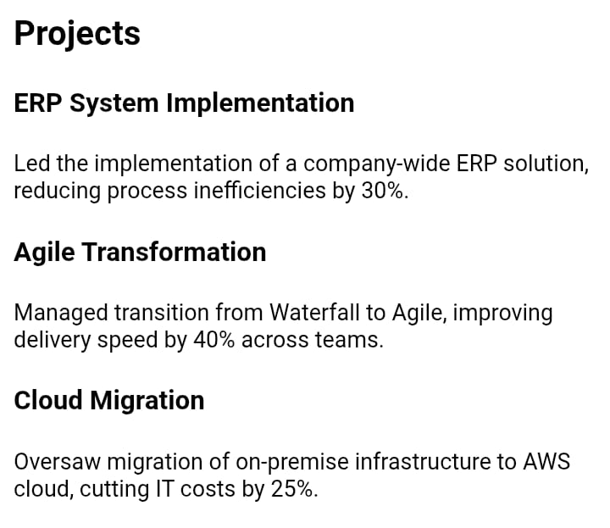
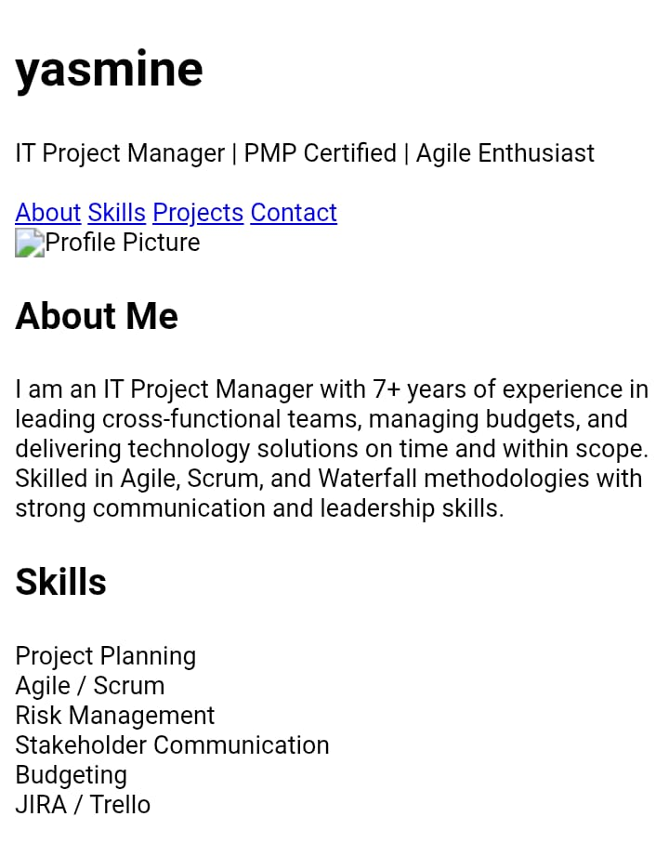

RESULTS AND SCREENSHOTS
3/21/2024 Annual Review
10

Slide 11
CONCLUSION
The IT Project Manager portfolio website successfully provides a professional, responsive, and interactive platform to showcase skills, achievements, and projects. It enhances digital presence and creates an easy way for employers and clients to connect. It highlights both technical and managerial expertise in a structured format. The responsive design ensures accessibility across devices. Interactive features improve user engagement and usability. Overall, the project strengthens professional branding in the digital era.
11

